Slide 1


TEKATHON-5.0- 2026
SamadhanPath
Problem Statement ID – SIH26129
Problem Statement Title – System integration and interoperability among government digital platforms, resulting in fragmented service delivery
Theme – Miscellaneous
PS Category – Software
Team Name (Registered on portal) – Code Matrix

Slide 2
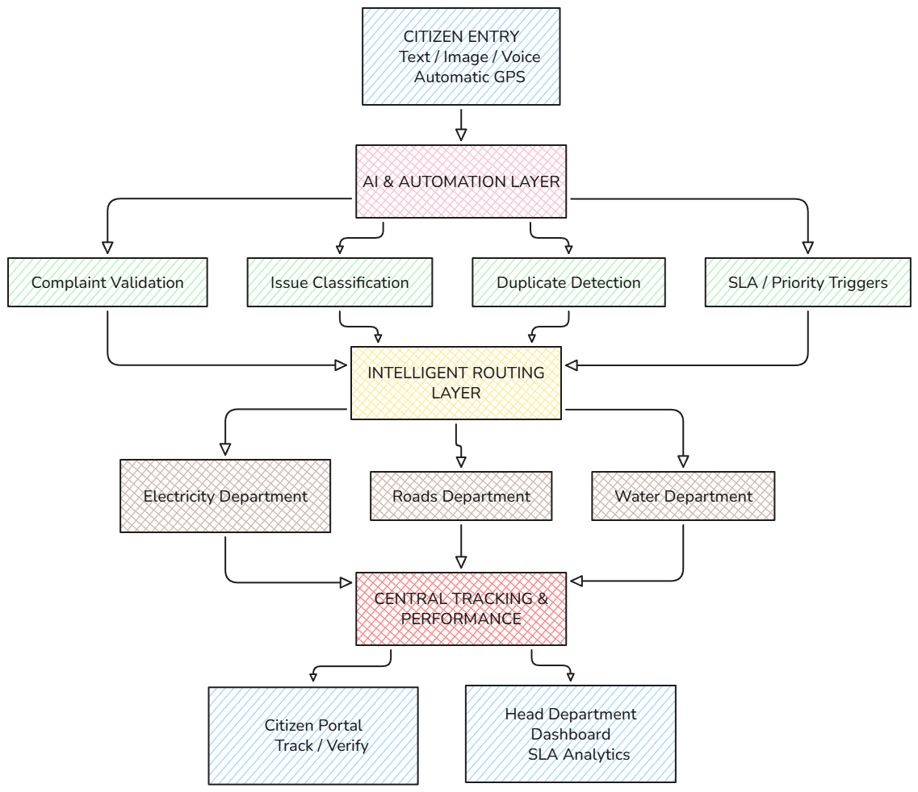
SamadhanPath
Proposed Solution: Transitioning government services from a fragmented maze into a single, intelligent orchestration layer.
The Fragmented Reality (Current Process): Citizens must manually identify, navigate, and register identical issues across isolated platforms like Municipal, Electricity, Water, or Welfare portals. This produces repeated data submissions, routing delays, and an invisible administrative workload.
The Orchestrated Solution (Proposed Process): SamadhanPath acts as a unified entry point. Citizens simply report an issue using text, image, or voice. The platform automatically extracts location, classifies the problem, and dynamically routes it to the correct department's queue while maintaining a single tracking identity.
Core Innovation: It does not replace existing departmental infrastructure. Instead, it functions as an interoperability layer that leaves backend operations intact while providing a unified service experience.

Slide 3
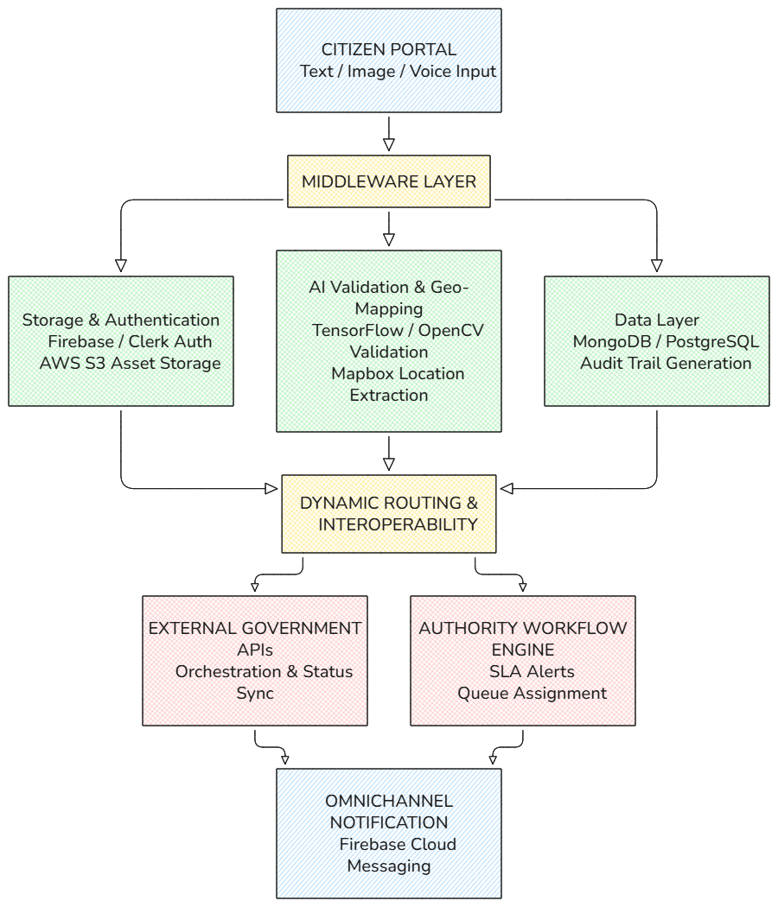
TECHNICAL APPROACH
Technologies Used:
Frontend: React + Tailwind + PWA
Backend: Node.js + Express
Database: MongoDB / PostgreSQL
Auth: Clerk / Firebase Auth
AI Layer: TensorFlow.js / OpenCV
Storage: AWS S3 / Firebase Storage
Maps: Google Maps / Mapbox
Notifications: Firebase Cloud Messaging
Github
Core Architectural Workflows:
Ingestion & Authentication: Secure onboarding via Clerk or Firebase Auth where citizen inputs undergo multimedia verification.
Orchestration Middleware: Node.js acts as an interoperability bus, normalizing conflicting data formats from external departmental systems.
Intelligent Automation: TensorFlow.js handles classification, matching issues directly to municipal queues while Mapbox correlates coordinates against administrative jurisdictions.

Slide 4
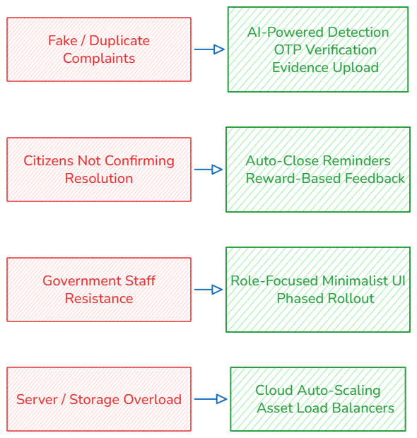
FEASIBILITY AND VIABILITY
Feasibility of the Idea:
Proven Technology: Similar applications already function reliably at scale using standard full-stack web and map services.
Low Setup Cost: System development and platform maintenance are highly affordable due to open-source frameworks and cloud free tiers.
Government Need: Public administrative agencies actively resolve millions of digital complaints and require better cross-department orchestration.
High User Interest: Citizens demand these unified services for single-entry convenience, transparency, and tracking.
Technical Resiliency Plan:
Fallback Routing: If an external departmental system API becomes unavailable, incoming request payloads are safely queued and retried automatically to preserve operational data.
Administrative Controls: Keeps processing safe by maintaining explicit human verification layers where department administrators can override low-confidence AI routing parameters.

Slide 5
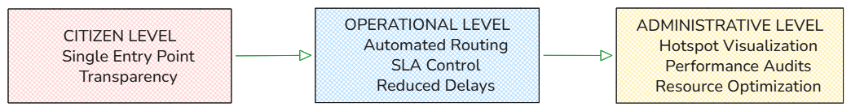
IMPACT AND BENEFITS
Potential Impact on the Target Audience:
Empowers Citizens: Provides a single, unified entry point for multiple services, eliminating confusion about departmental ownership.
Increases Transparency: Enables real-time progress monitoring from submission to final resolution using a unique tracking identity.
Motivates Participation: Drives citizen engagement through immediate tracking feedback, notifications, and verification mechanisms.
Reduces Administrative Friction: Eradicates the need to submit duplicate records or manually track across separate departmental systems.
Benefits of the Solution:
Social Impact: Democratizes public service access, speeds up grievance resolutions, and bridges the communication gap between citizens and authorities.
Economic Efficiency: Lowers setup and operational costs through cloud infrastructure, reduces duplicated workloads, and identifies recurring infrastructure asset issues to optimize long-term maintenance budgets.
Environmental & Operational Sustainability: Leverages geographic data to identify infrastructure problem areas (e.g., water leaks, waste management accumulation), reducing resource wastage and promoting proactive governance.
Socio-Economic & Operational Value Flow:

Slide 6
RESEARCH AND REFERENCES
Details / Links of the Reference and Research Work:
  Personal Research: Deep domain investigation using cloud storage resource repositories, comparative project design docs, and published technical research papers on enterprise middleware.
  Government Websites: Baseline operational flows and SLA standards mapped directly from official Indian grievance and service delivery infrastructures:
    CPGRAMS – Centralised Public Grievance Redress and Monitoring System: https://pgportal.gov.in/
    National Government Services Portal: https://services.india.gov.in/
  AI & Open-Source ML Repositories: Large Language Models used for code synthesis and architectural brainstorming, combined with public datasets and pre-trained pipelines for classification tasks:
Foundational AI Engines: Claude, Perplexity
ML Assets & Open Notebooks: Kaggle Datasets, Hugging Face Model Hub, Ultralytics YOLOv8 Repositories
  Public Information Indexes: General knowledge validation, schema verification, and engine mapping:
    Open Government Data (OGD) Platform India: https://data.gov.in/
    Metadata & Data Standards (MDDS) / API Setu Documentation: https://docs.apisetu.gov.in/document-central/mdds/Introduction.html
Project Resources & Prototype Evidence: Links to the project documentation, working prototype, and demonstration:
Live Prototype: https://jansetu-nq8s.onrender.com/
Demonstrates the citizen portal, department dashboards, authentication, complaint handling, and other key features.
Project Documentation: https://drive.google.com/drive/folders/1HBC23cqqkyiY4R07rE0eK9fj5LzPM57p?usp=drive_link
Includes research, diagrams, feasibility studies, SDLC documents, acceptance criteria, and technical references.
Prototype Demonstration: https://drive.google.com/drive/folders/1tkv5C6uyZRkYQMvk8dGtS7vpGJ21Ca27?usp=sharing
Provides a walkthrough of the prototype, user flow, dashboards, and main functionalities.

